Slide 1
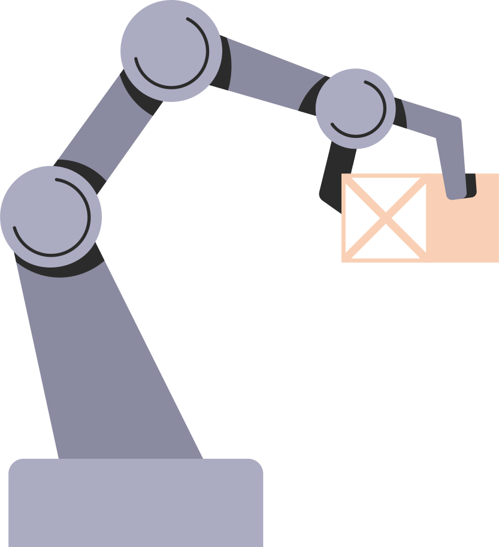
Industry 4.0
Presentation by: Rohan Joydhar
Roll No: 251/18, Registration: 18053540012
B.Tech, 4th year, MME
Last edited: 27th May, 2022
Guided by: Dr. Ghanshyam Das

Slide 2

01 Introduction.
02 History.
03 Era of Industry 4.0.
04 Technologies.
05 Conclusion.
Table of content.

Slide 3
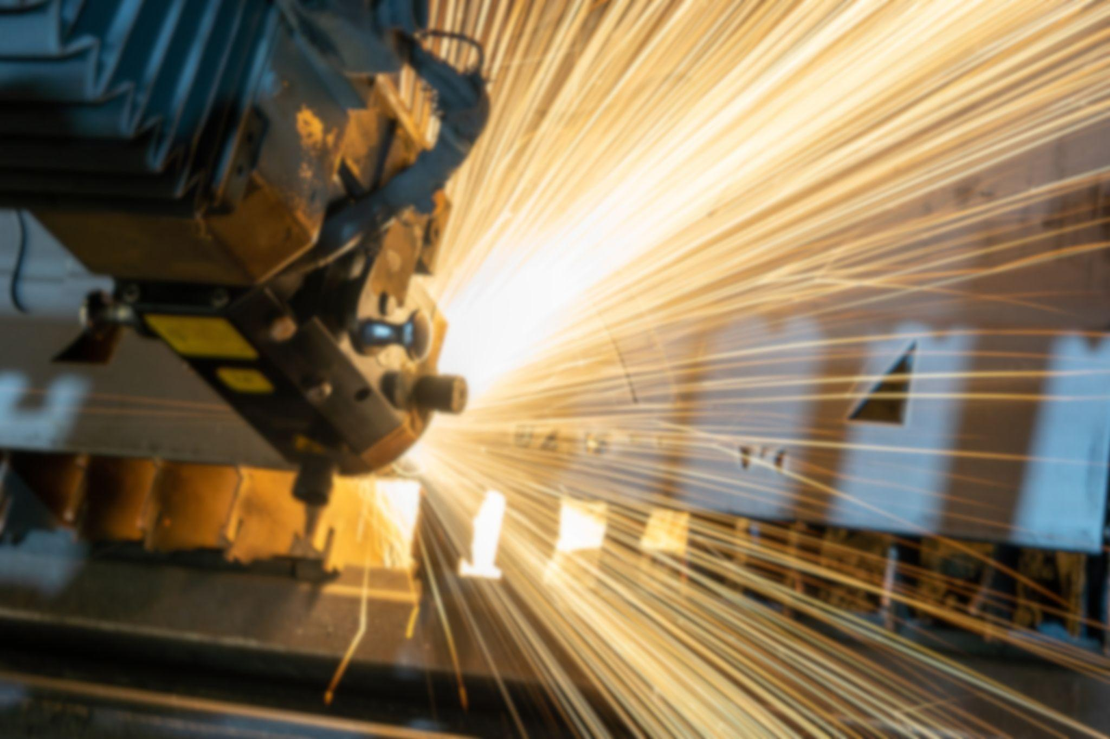
Introduction.:
The 4th industrial has begun, and this isn’t not going to be like before. It’s not about the steam that powered our factories in the 1st revolution or the mass production line that dominated the 2nd or even the emergence of computer driven systems from the 3rd revolution, that we’re living in today.
Industry 4.0 is about connectivity. It’s an opportunity to radically change the way industry responds to the need of society, as the previous industrial revolution was led by innovations and manufacturing processes and systems, the advancements of Industry 4.0 will be driven by a smart interconnected & pervasive environment.

Slide 4
From steam to sensor: historical context for Industry 4.0

Slide 5
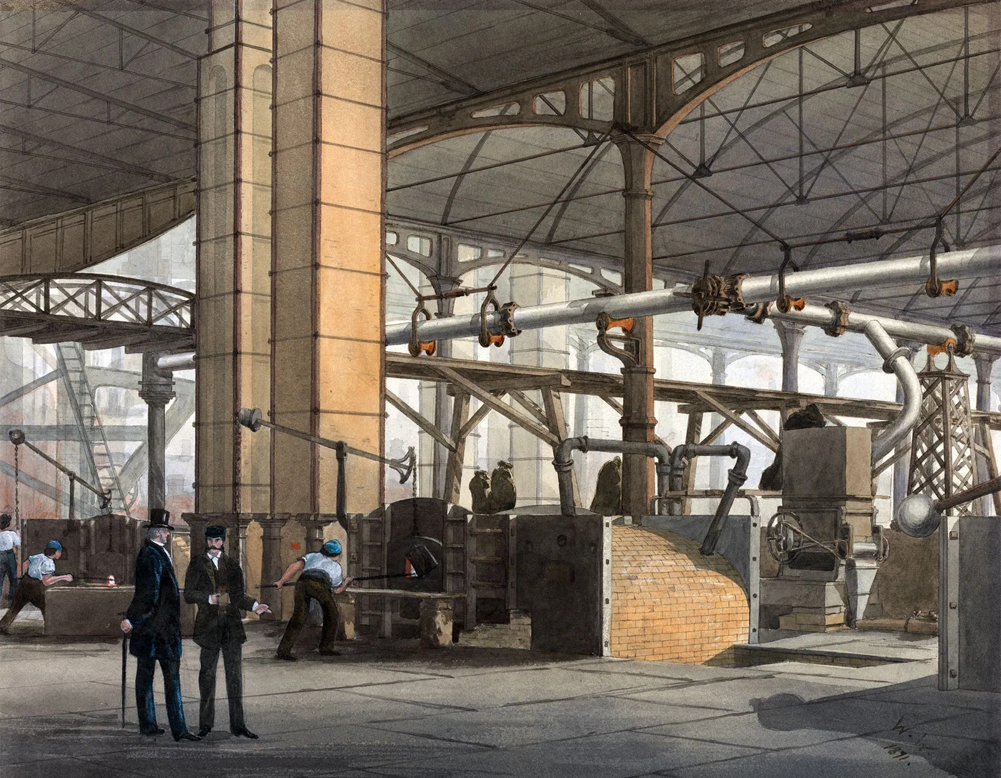
1st industrial revolution.:
Starting in the late 18th century in Britain, the first industrial revolution helped enable mass production by using water and steam power instead of purely human and animal power. Finished goods were built with machines rather than painstakingly produced by hand.

Slide 6
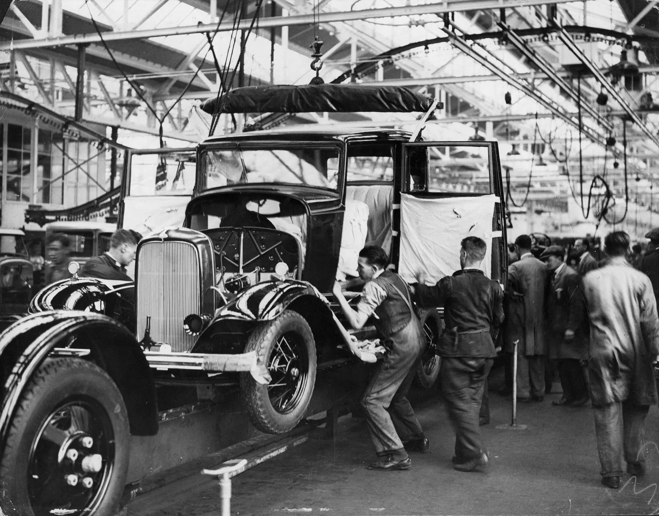
2st industrial revolution.:
A century later, the second industrial revolution introduced assembly lines and the use of oil, gas and electric power. These new power sources, along with more advanced communications via telephone and telegraph, brought mass production and some degree of automation to manufacturing processes.

Slide 7
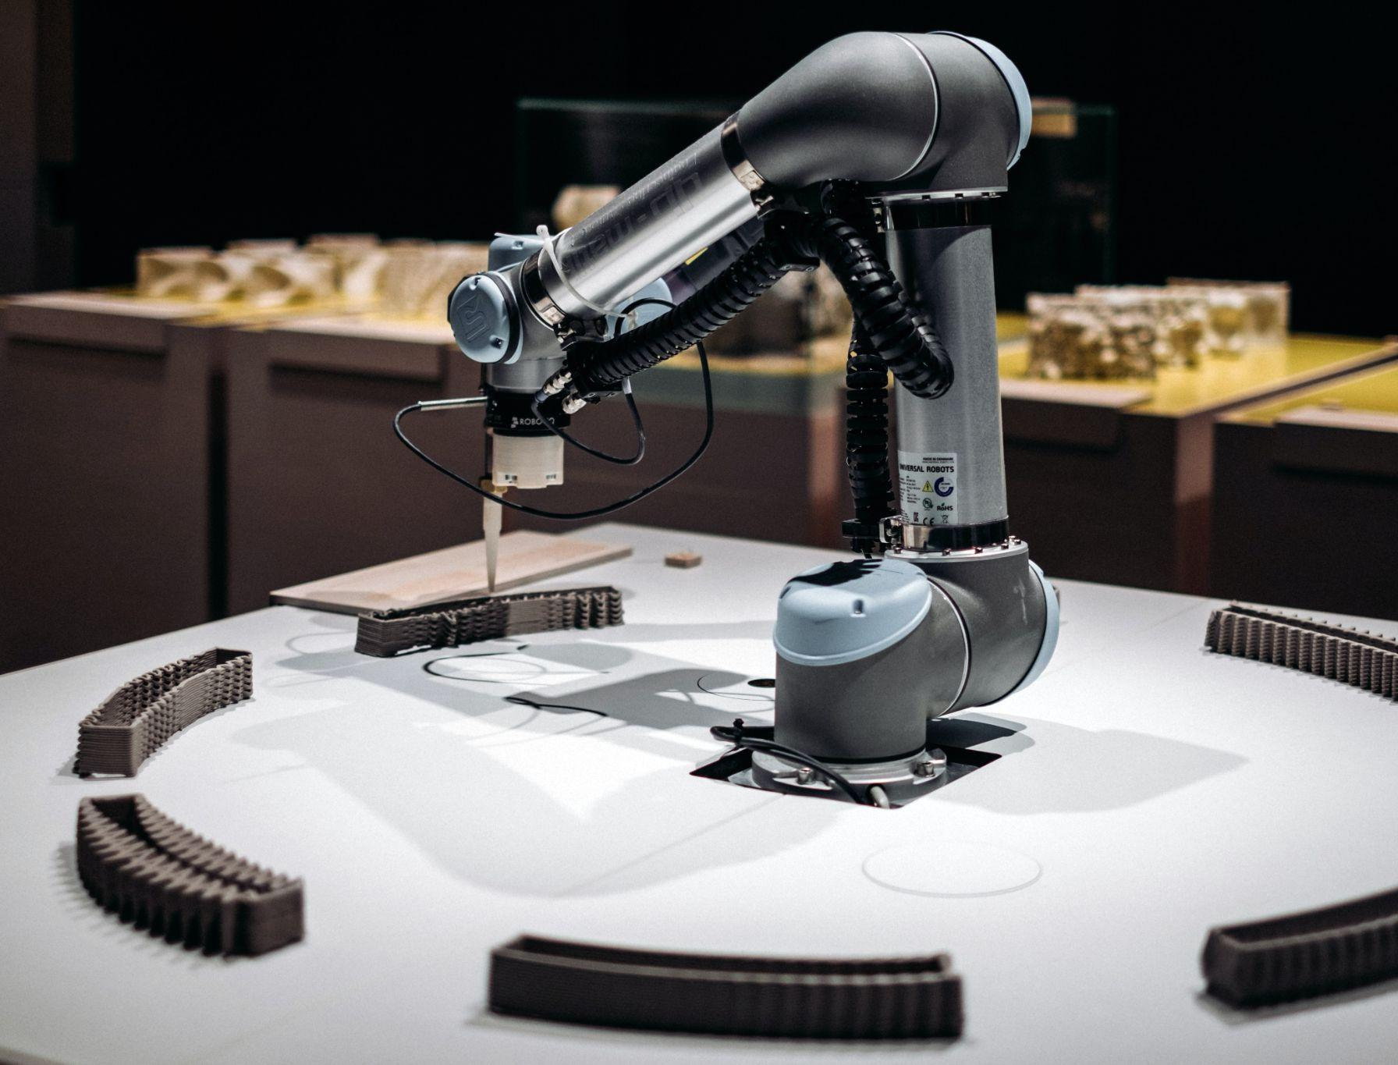
3st industrial revolution.:
The third industrial revolution, which began in the middle of the 20th century, added computers, advanced telecommunications and data analysis to manufacturing processes. The digitization of factories began by embedding programmable logic controllers (PLCs) into machinery to help automate some processes and collect & share data.

Slide 8
4st industrial revolution.:
We are now in the fourth industrial revolution, also referred to as Industry 4.0 characterized by increasing automation & the employment of smart machines & smart factories, informed data helps to produce goods more efficiently and productively across the value chain. Flexibility is improved so that manufacturers can better meet customer demands using mass customization — ultimately seeking to achieve efficiency with, in many cases, a lot size of one. By collecting more data from the factory floor and combining that with other enterprise operational data, a smart factory can achieve information transparency & better decisions.

Slide 9
Industry 4.0 & technologies are changing the way of manufacturing.

Slide 10
1
Industry 4.0 is revolutionizing the way companies manufacture, improve and distribute their products. Manufacturers are integrating new technologies, including Internet of Things (IoT), cloud computing & analytics, AI & ML into their production facilities & throughout their operations.
3
This digital technologies lead to increased automation, predictive maintenance, self-optimization of process improvements & above all, a new level of efficiencies & responsiveness to customers not previously possible.
Developing smart factories provides an incredible opportunity for the manufacturing industry to enter the fourth industrial revolution. Analyzing the large amounts of big data collected from sensors on the factory floor ensures real-time visibility of manufacturing assets & can provide tools for performing predictive maintenance in order to minimize equipment downtime.
2
These smart factories are equipped with advanced sensors, embedded software and robotics that collect and analyze data & allow for better decision making. Even higher value is created when data from production operations is combined with operational data from ERP, supply chain, customer service and other enterprise systems to create whole new levels of visibility & insight from previously siloed information.

Slide 11

4
Using high-tech IoT devices in smart factories leads to higher productivity and improved quality. Replacing manual inspection business models with AI-powered visual insights reduces manufacturing errors and saves money & time. With minimal investment, quality control personnel can set up a smart phone connected to the cloud to monitor manufacturing processes from virtually anywhere. By applying machine learning algorithms, manufacturers can detect errors immediately, rather than at later stages when repair work is more expensive.
Industry 4.0 concepts and technologies can be applied across all types of industrial companies, including discrete & process manufacturing, as well as oil and gas, mining & other industrial segments.

Slide 12
Technologies driving Industry 4.0

Slide 13
Key technologies.:
01 Internet of Things.
03 Cloud computing.
05 Big data & analytics.
07 Cyber security.
02 Edge computing.
04 AI & Machine learning.
06 DIgital twin.
08 Smart manufacturing.

Slide 14
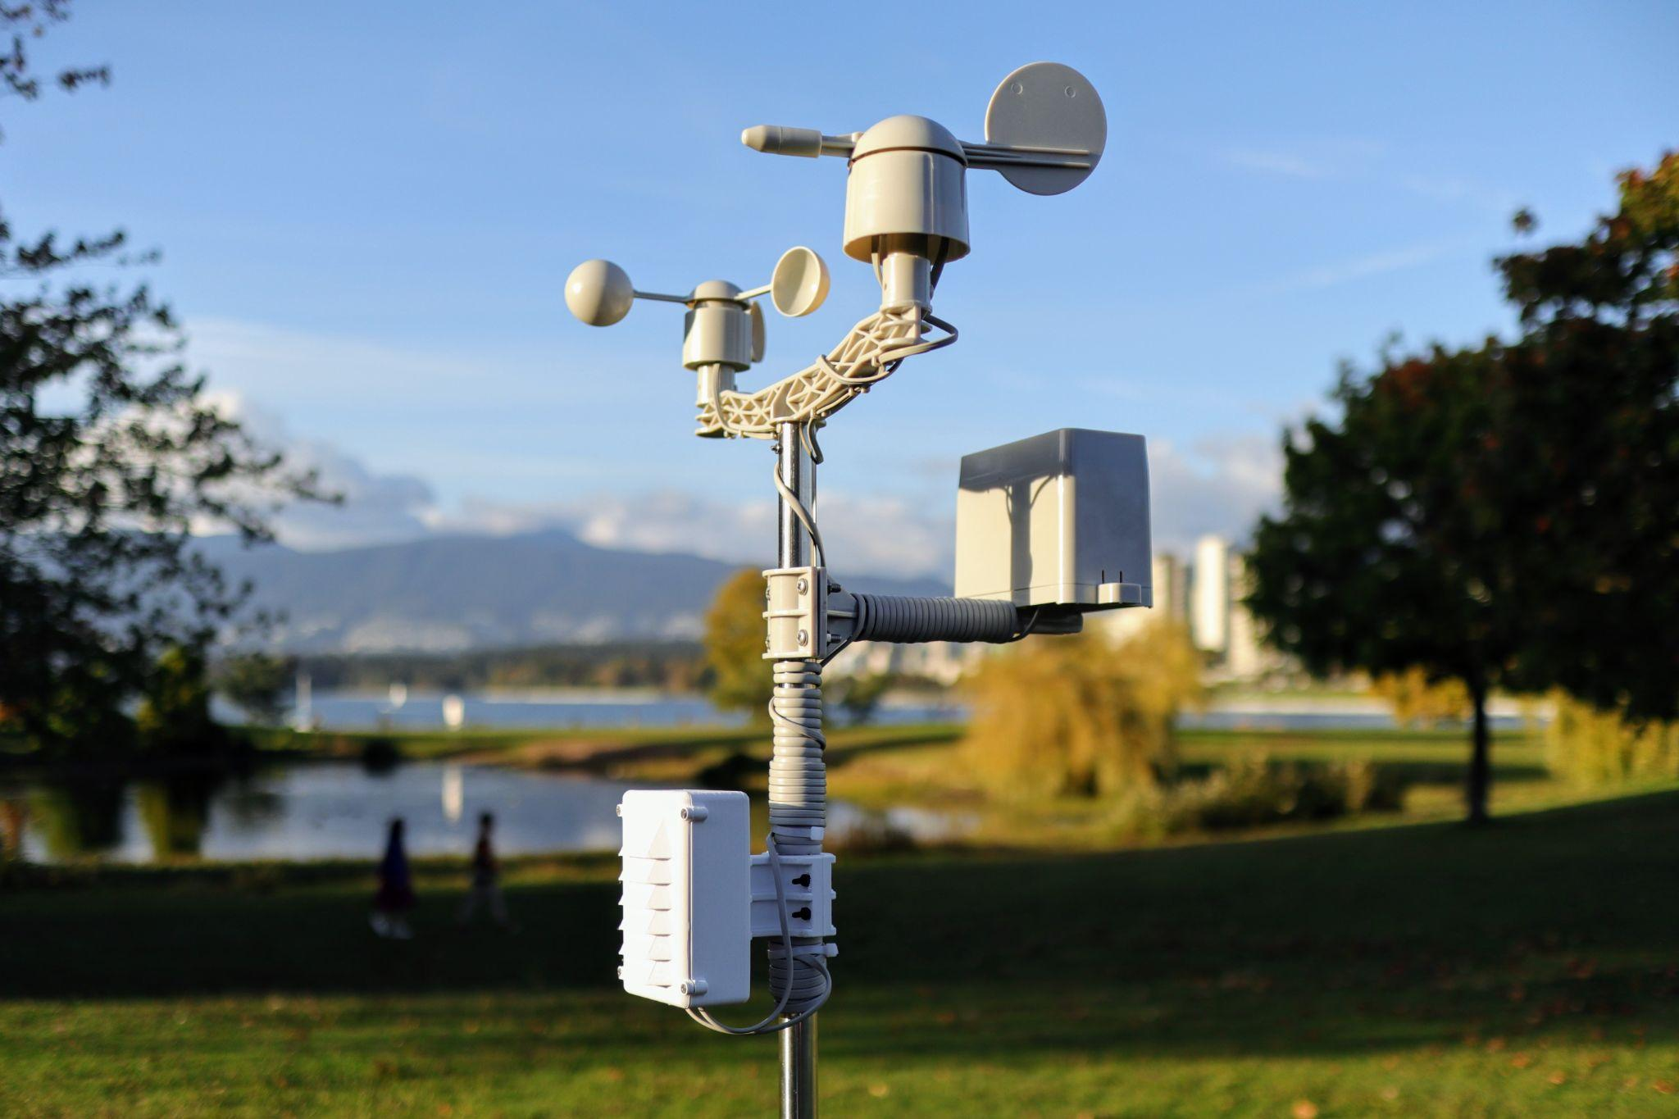
Internet of Things (IoT)
The Internet of Things (IoT) is a key component of smart factories. Machines on the factory floor are equipped with sensors that feature an IP address that allows the machines to connect with other web-enabled devices. This mechanization and connectivity make it possible for large amounts of valuable data to be collected, analyzed and exchanged.

Slide 15

Edge computing
The demands of real-time production operations mean that some data analysis must be done at the “edge” —that is, where the data is created. This minimizes latency time from when data is produced to when a response is required. For instance, the detection of a safety or quality issue may require near real-time action with the equipment. The time needed to send data to the enterprise cloud and then back to the factory floor may be too lengthy and depends on the reliability of the network. Using edge computing also means that data stays near its source, reducing security risks.

Slide 16

Cloud computing
Cloud computing is a cornerstone of any Industry 4.0 strategy. Full realization of smart manufacturing demands connectivity and integration of engineering, supply chain, production, sales and distribution, and service. Cloud helps make that possible. In addition, the typically large amount of data being stored and analyzed can be processed more efficiently and cost-effectively with cloud. Cloud computing can also reduce startup costs for small- and medium-sized manufacturers who can right-size their needs and scale as their business grows.

Slide 17

AI and machine learning
AI and machine learning allow manufacturing companies to take full advantage of the volume of information generated not just on the factory floor, but across their business units, and even from partners and third-party sources. AI and machine learning can create insights providing visibility, predictability and automation of operations and business processes. For instance, industrial machines are prone to breaking down during the production process. Using data collected from these assets can help businesses perform predictive maintenance based on machine learning algorithms, resulting in more uptime & higher efficiency.

Slide 18

Big data & analytics
The digital transformation offered by Industry 4.0 has allowed manufacturers to create big datasets containing data collected from thousands of IoT devices. These datasets are further analyzed to find trends that help manufacturers to make smarter decisions & act according to the market.

Slide 19
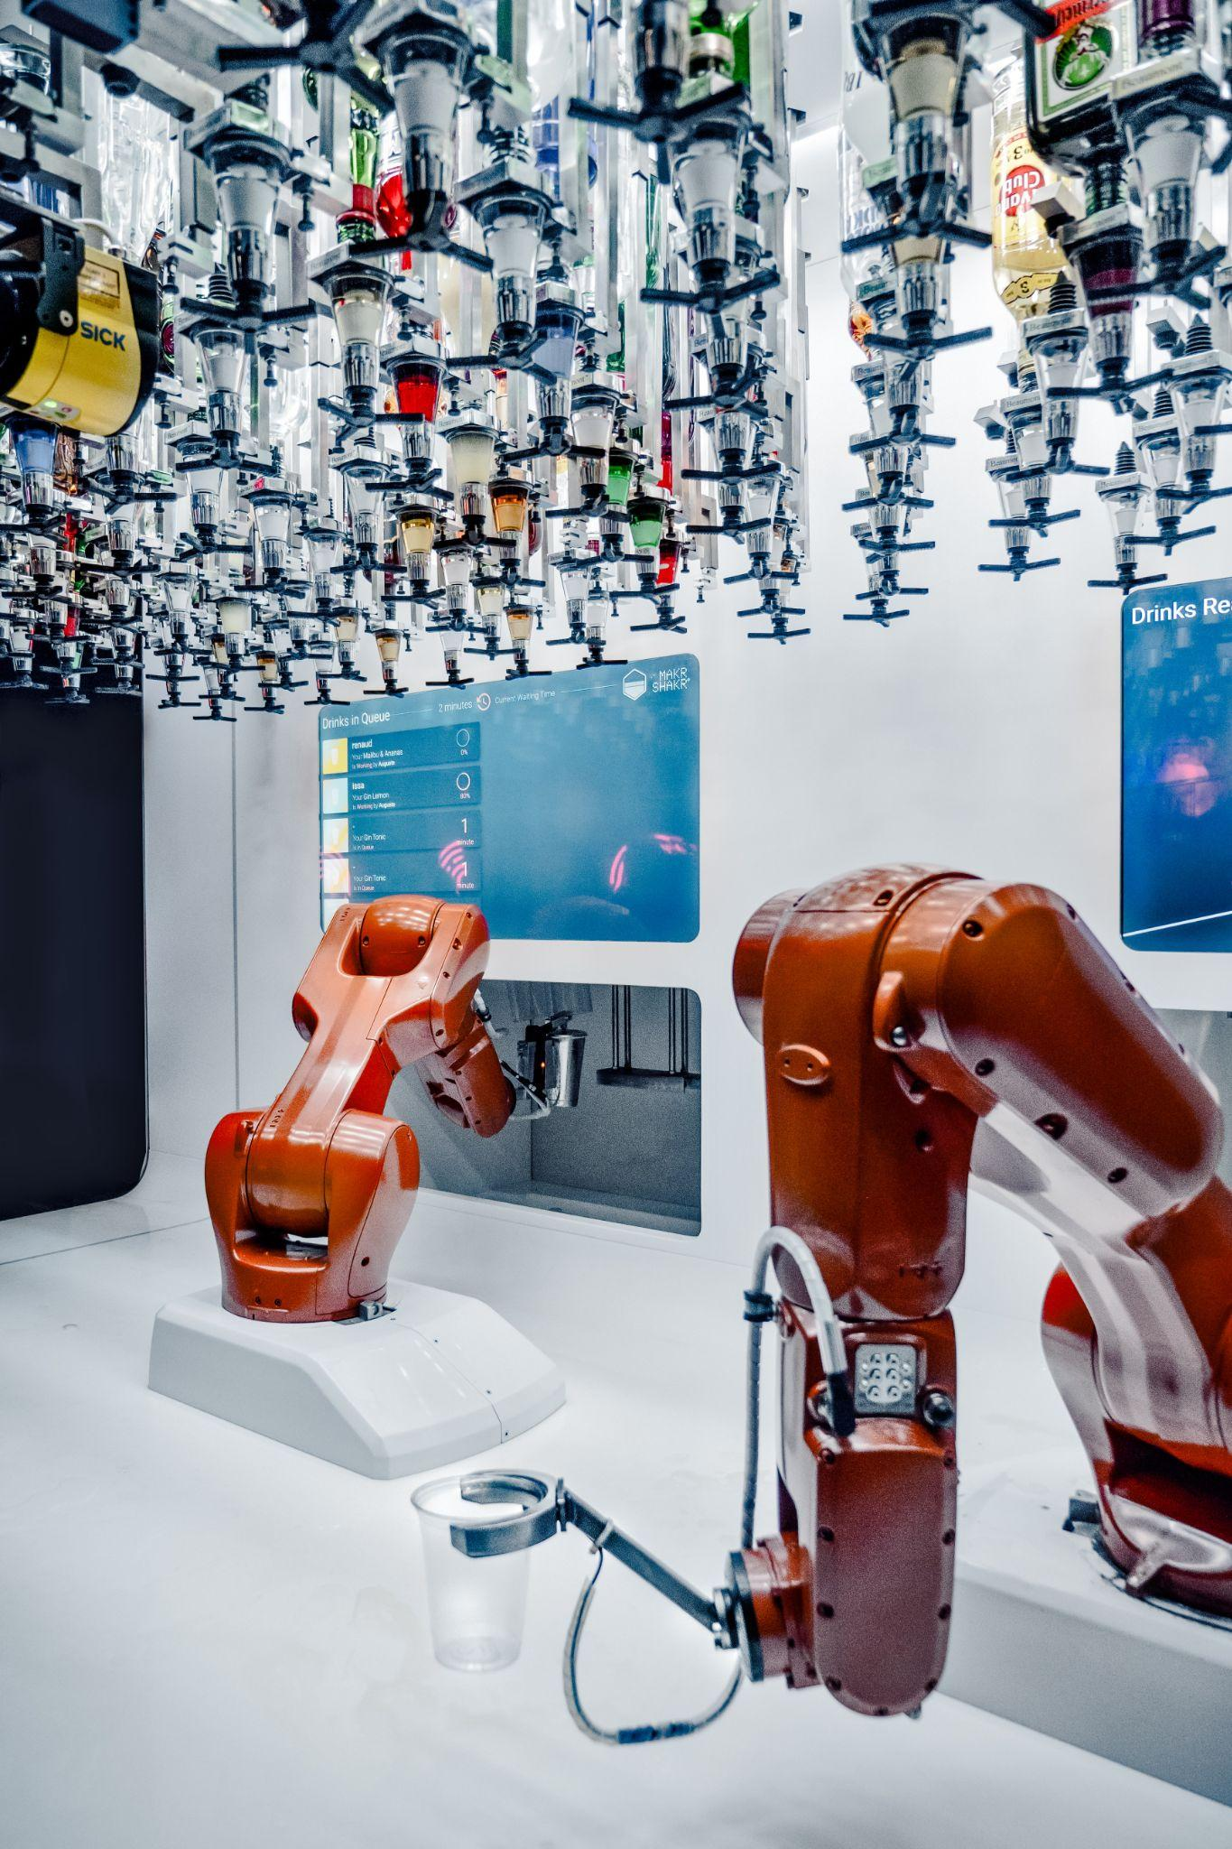
Digital twin
The digital transformation offered by Industry 4.0 has allowed manufacturers to create digital twins that are virtual replicas of processes, production lines, factories and supply chains. A digital twin is created by pulling data from IoT sensors, devices, PLCs and other objects connected to the internet. Manufacturers can use digital twins to help increase productivity, improve workflows and design new products. By simulating a production process,
For example, manufacturers can test changes to the process to find ways to minimize downtime or improve capacity.

Slide 20

Cybersecurity
Manufacturing companies have not always considered the importance of cybersecurity or cyber-physical systems. However, the same connectivity of operational equipment in the factory or field that enables more efficient manufacturing processes also exposes new entry paths for malicious attacks & malware. When undergoing a digital transformation to Industry 4.0, it is essential to consider a cybersecurity approach that encompasses IT and OT equipment.

Slide 21
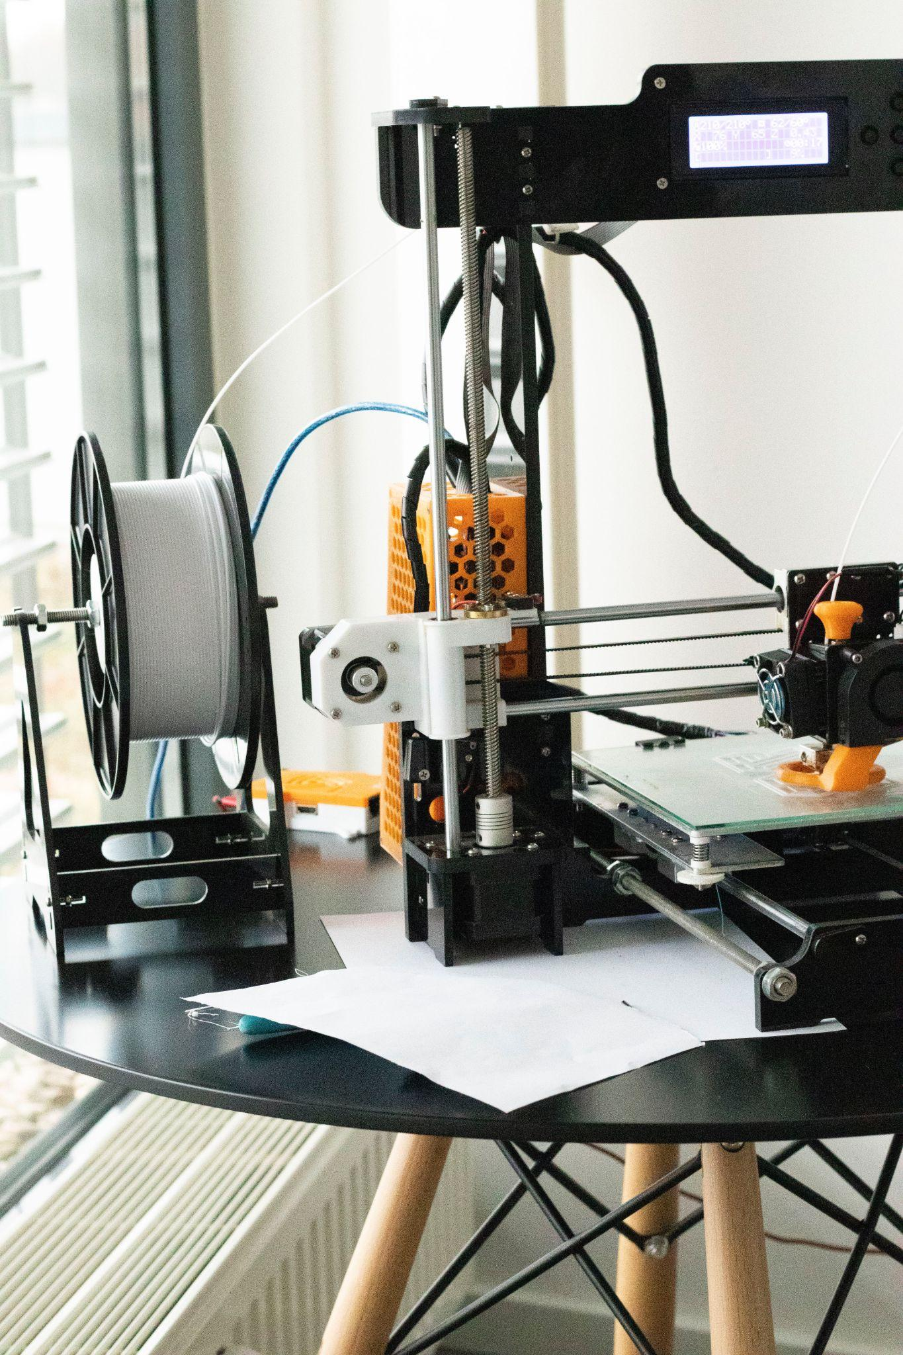
Smart manufacturing
The digital transformation offered by Industry 4.0 has allowed manufacturers to analyze and recognize the trends to fulfill the demand & supply. With the help of IoT and Big Data analytics production lines, are now becoming smarter & more efficient.

Slide 22

Industry 4.0 in Steel Industry
Industry 4.0 enables factories smart, products smart, and supply chains smart as well, and makes manufacturing systems and services more agile, flexible, and responsive to customers.
In steel industry Tata steel uses AI based cameras to detects rhomboidity of billets.
Using of IoT based robots are very common to carry heavy payload during delivery.
Automated casting units are currency used for manufacturing.
AI & ML helps us to predict future demands & supply.
Analysing data from IoT sensors can help us to find answers of a manufacturing defect.

Slide 23

Conclusion
Industry 4.0 enables factories smart, products smart, and supply chains smart as well, and makes manufacturing systems and services more agile, flexible & responsive to customers. Through a brief overview of Industry 4.0 & enabling technologies, this seminar discussed the possible changes in factories, products, customers, and businesses in the environment of Industry 4.0. The attributes of manufacturing systems and services with Industry 4.0 were highlighted & the benefits brought by Industry 4.0 to businesses were discussed. To be more specific, the seminar focused on inventory systems & optimization. The impact of Industry 4.0 on inventory systems and optimization was explored, respectively. The new integrative R&D framework for inventory systems & optimization was proposed in Industry 4.0.

Slide 24
Industry 4.0 in Steel Industry
Industry 4.0 enables factories smart, products smart, and supply chains smart as well, and makes manufacturing systems and services more agile, flexible, and responsive to customers.
In steel industry Tata steel uses AI based cameras to detects rhomboidity of billets.
Using of IoT based robots are very common to carry heavy payload during delivery.
Automated casting units are currency used for manufacturing.
AI & ML helps us to predict future demands & supply.
Analysing data from IoT sensors can help us to find answers of a manufacturing defect.

